Slide 1
Maryland Medicaid: Telligen Provider Portal
Air Ambulance
September 2022
Notes:
Welcome to the the Telligen Provider Portal Air Ambulance training. We thank you so much for taking time out of your day to learn about our future working relationship with Air Ambulance providers and the Maryland Department of Health. Telligen has worked very closely over the last several years with the Maryland Dept of Health as their Utilization Control Agent for Maryland Medicaid reviews. We are very excited to continue our working relationship with the Maryland Dept of Health as we begin to process Air Ambulance medical necessity reviews. My name is Rhonda McLaughlin. I am the supervisor for Durable Medical Equipment reviews and will be working with you and the department as we transition to performing Maryland’s Air Ambulance utilization reviews.

Slide 2
Agenda
Program Goals
Summary of Process Changes
Air Ambulance Criteria
Air Ambulance Reimbursement and Requests for Reconsideration
Website
How to enter a review
View Outcomes
Request for Reconsideration
E-mail notifications
Questions
Notes:
We have many topics to cover today during our presentation. John Pelton for the Maryland Department of Health will review with us The MDH Program Goals, Summary of MDH process changes, Air Ambulance Criteria, Air Ambulance Reimbursement and Requests for Reconsideration I will then continue the presentation with The Telligen Website including our Qualitrac provider portal, How to enter a review into our Provider Portal, Viewing Outcomes of requests, Requesting a reconsideration of a denied request, E-mail notifications from our Provider Portal and we will save questions until the end of our presentation. Without further ado, I will turn things over to John to get us started.

Slide 3
Program Goals
Effective October 1, 2022, Telligen will assume the responsibility for reviewing and authorizing Air Ambulance Rotary Wing (RW) claims.
Enhanced Electronic Claims Management
Improved Provider Experience
Leveraging Technology and Time
Streamlined Claims Processing
Online Provider Portal for Claims Status
Payments issued by State of Maryland
Decrease and eliminate delayed payment

Slide 4
Summary of Process Changes
Old Process | New Process
Claims & documentation must be mailed | Simply upload claim and relevant documentation into the Qualitrac system
Provider must call Baltimore City for claim status | Vendor will be notified via email with any change of claim status. Vendor can also check Qualitrac system for claim status
Must call Baltimore City Health Department for any questions or issues | Telligen has a dedicated Toll-Free number to address any questions
Local Health Department EMTs and nurses examine claims | A dedicated team of transport specialty nurses & physicians will review claims in consultation with MDH specialists
Claims review & decision has no set timeframe | Telligen will review claims within a contractual timeframe

Slide 5
Air Ambulance Criteria
Approval or denial of claims will be made using the same criteria that have been in place.
Transportation for a Medicaid Covered Service, not available at the sending facility, at a Maryland Medicaid Provider.
Medical Necessity
Transportation by ground is contraindicated
Closest Appropriate Facility
Not for the convenience or preference of the provider or participant
Notes:
The criteria for RW air transport to a Maryland Medicaid participant continue to be based on:
1. Transportation for a Medicaid Covered Service, not available at the sending facility, at a Maryland Medicaid Provider.
2. Medical Necessity - Transportation by ground is absolutely contraindicated due to time, distance, and clinical interventions beyond the scope of available ground ambulance licensed at the clinically appropriate level.
3. Closest Appropriate Facility - A closer appropriate facility was documented by the sending facility as unavailable or not willing to accept the participant. Transportation cannot be for the convenience or preference of the participant or provider.

Slide 6
Air Ambulance Reimbursement and Requests for Reconsiderations
Claims will continue to be reimbursed at the base rate of $1,500 with $20 per loaded mile to the closest appropriate facility.
Providers will have the opportunity to request reconsideration reviews in the Qualitrac Provider Portal.

Slide 7
Overview of New Claim Submission Process
Enroll in Qualitrac
Submit completed claim electronically
Include all supporting documentation
Action Taken in the Portal
Requesting additional information
Definitive Disposition
Denial
Request Additional Reviews
Payment Processed via Maryland Department of Health

Slide 8
Website
Notes:
Thanks John. Telligen’s Website and our Provider portal

Slide 9
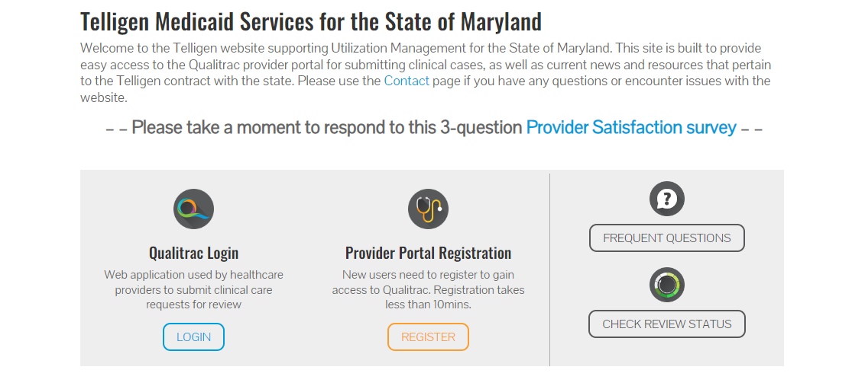
Telligen Provider Portal
The Telligen Provider Portal is a web application that allows healthcare providers to submit review requests.
Please bookmark the telligenmd.Qualitrac.com webpage.
Use the Log-In link in the middle left side of the website.
Notes:
The telligen provider portal is a web application that allows providers to submit review requests. The portal is available anywhere that you have an internet connection. The provider portal is directly accessed though Telligen website: telligenmd.qualitrac.com. Please bookmark this site. Telligen uses a software program designed by our company call Qualitrac which can be accessed by clicking on a link on the middle left side of the website. We also use our website to post any provider upates regarding any of our review processes and training links such as this training for future review. In the middle of the website there is a line for Provider Portal Registration. This is where the Air Ambulance company will go to register for the Qualitrac Provider Portal Website.

Slide 10
Authorized Official Training
Notes:
The portal utilizes what is called a delegated security model. This means that an executive at the organization will need to select or delegate one or more individuals to be the Authorized Official for the air ambulance provider.

Slide 11
Authorized Official Training
Authorized Officials:
Ability to Add and Deactivate users.
Reset Passwords
Still able to submit and view reviews that are submitted by individuals in the same organization(s)
Notes:
As an Authorized Official you have the

Slide 12
Authorized Official Training
Authorized Officials will see an option in the top menu that other users that are not Authorized Officials will not see.
Click on the tool icon to get the drop-down menu to show and then click on Manage Users.

Slide 13
Authorized Official Training
The Authorized Official will be able to see all users that are associated with any organizations/physicians that the AO is associated to.
The AO can click on any of the blue links in the line to get to the details for the user.

Slide 14
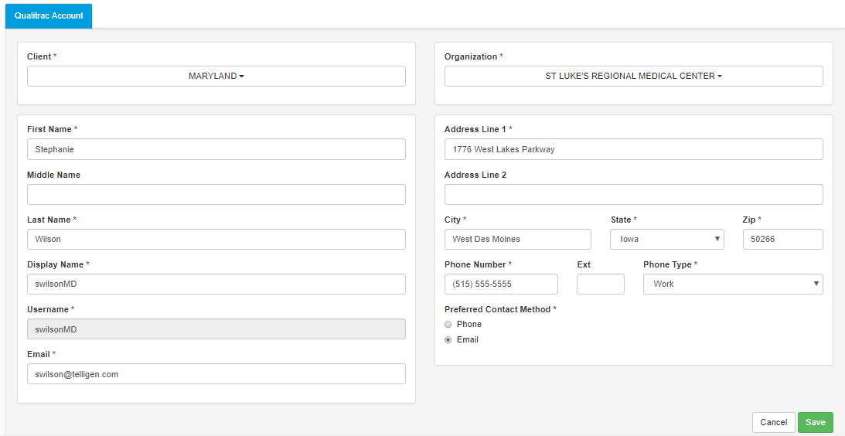
Authorized Official Training

Slide 15
Authorized Official Training
The Authorized Official and the individual User will be able to edit any of their information (address, phone, last name, etc) except for the Username field.
Once a username is created, it cannot be changed. The user would have to be deactivated and set-up again to have a different username.
There can only be one username in the system. If another user is set up and matches on a username already in the system, the user will not be saved and the AO will be forced to enter a new username that does not match with any others.

Slide 16
Authorized Official Training
Set up a new user
Click the Add User button the top right corner of the Manage User page.
All fields with a red asterisk, *, are required fields.
The Organizations drop down will allow the AO to associate users to the organization(s)/physician group(s) that are available to the AO to select from. Check the box next to each one to select it.

Slide 17
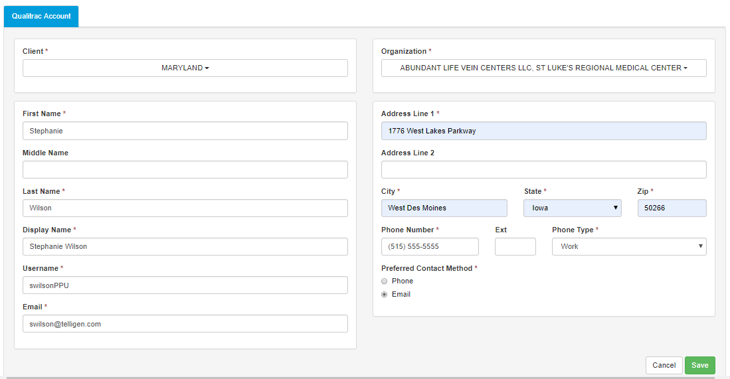
Authorized Official Training
Setting up a new user

Slide 18
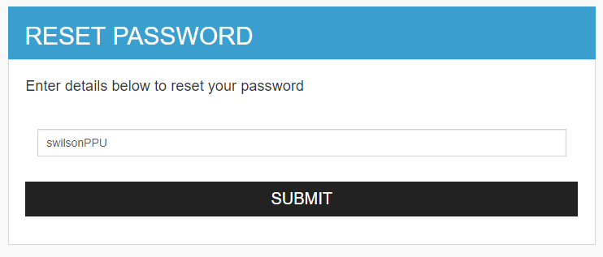
Authorized Official Training
Set up a new user
After clicking save, the system will direct the AO to the Reset Password page.
The Username will be defaulted for the user. Any time a password needs to be reset, always enter the Username and not an email address.
This sends an email to the user with a link to reset their password to log in for the first time.

Slide 19
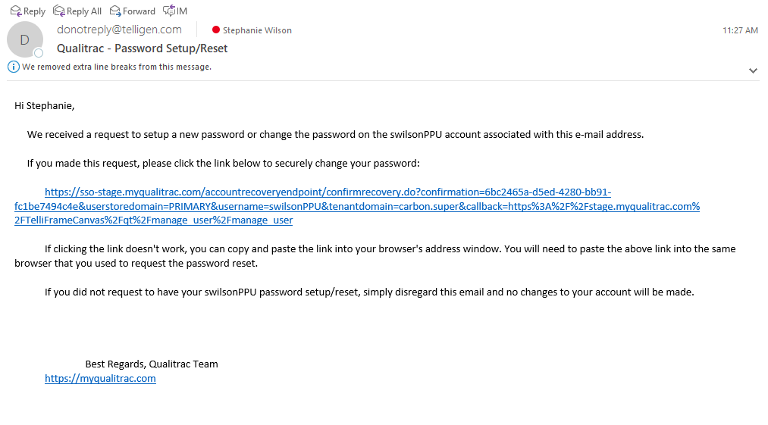
Authorized Official Training
Setting up a new user

Slide 20
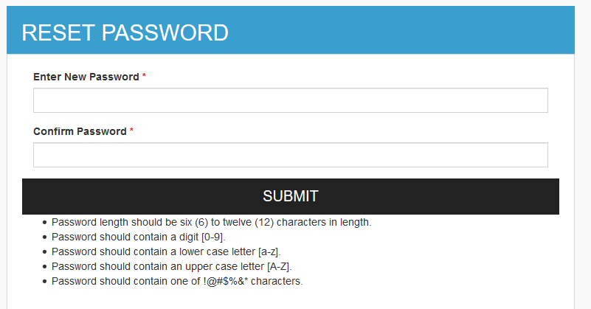
Authorized Official Training
Set up a new user
The user will follow the link and be taken to the reset password page.
Once a password is set up following the rules, the user will hit submit and be logged in to the system.

Slide 21
Provider Portal Training

Slide 22
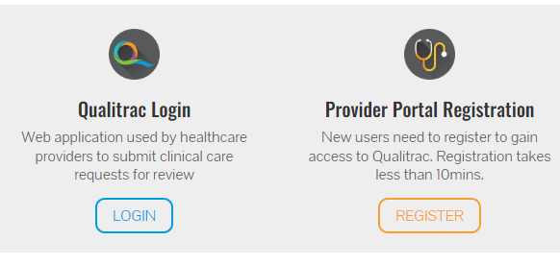
Provider Portal
To get started, navigate to the website: telligenmd.Qualitrac.com
Utilize the “Qualitrac Login” option in the middle-left side of the website to login to the Provider Portal.

Slide 23
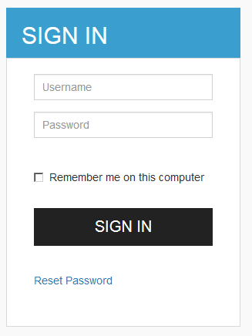
Provider Portal
On the sign-in page:
Use the username that you were assigned.
Use the password that you set up from the email.
Click Sign In to access the system
There is a “Reset Password” link below the sign-in button. This can be used to change/reset your password whenever it is needed.

Slide 24
Provider Portal: Landing Page

Slide 25
Provider Portal: Landing Page
This is the Telligen Provider Portal Menu Bar. This will remain available to you wherever you are in the system.
The Qualitrac Logo will take you back to the landing page from wherever you are currently working at in the system.
This “magnifying glass” will open up search options for you to search for a specific case or a specific member to view the details.
This is utilized to view and manage your profile. If your phone number or email address changes, you can use this section to update the details.
Our Qualitrac Team utilizes this “bell” to show any system messages. It will show anything that has occurred within the last 30 days.

Slide 26
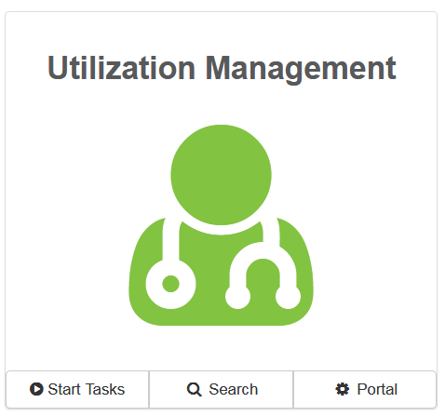
Telligen Provider Portal – Landing Page
Start Tasks will take you to the task queue to view any reviews where additional information has been requested
Search will allow you to search for a member or a case. Just like the magnifying glass at the top of the page.

Slide 27
Telligen Provider Portal – Adding a New Review
Click on the box to access the member search screen to look for information on a member or to start a new review.

Slide 28
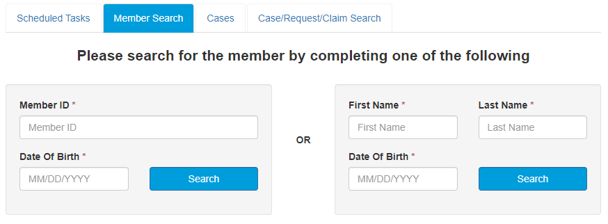
Telligen Provider Portal – Adding a New Review
Enter the Member ID and Date of Birth or the First Name, Last Name, and Date of Birth to start the search. The information must match with what is on file to locate the member information or to begin a new review for that member.

Slide 29
Telligen Provider Portal – Adding a New Review
Click on any of the data fields in blue to access the member information or to start a new review for the member.

Slide 30
Telligen Provider Portal – Adding a new review
You will now be at the Member Hub. This allows you to view any related information to this member. You will be able to see their contact information and any reviews that have been submitted for them.

Slide 31
Telligen Provider Portal – View Member Details
Clicking on the View Member Details box opens the window to provide the user with more information for the member.
Hide Member Details will minimize the panel to just see information across the top line.
View Even More Member Details will take the user to view member eligibility.

Slide 32
Telligen Provider Portal – Utilization Management Panel
The Utilization Management Panel will contain all information related to any UM reviews submitted for the member.
Per the panel, this member has not had any UM requests submitted for them.
Use the Add button to start a new request.

Slide 33
Telligen Provider Portal – Add New Request
To begin a new request, you will first fill in the Authorization Request panel.

Slide 34
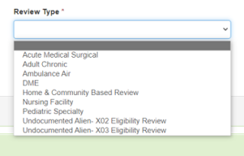
Authorization Request Panel: Review Type
Review Type: This is where you will select the type of review you are submitting the review for.
For Air Ambulance reviews, you will select Ambulance Air as the review type.

Slide 35
Authorization Request Panel
When the Review Type Ambulance Air is selected:
Place of Service Auto-populates to Ambulance-Air or Water
Type of Service Auto-populates to Ambulance
Timing Auto-populates to Retrospective
Once all the selections are filled in, you can select Cancel to remove the request or you can select Add New Request to complete the process.

Slide 36
Admission and Discharge Panel
Once you select Add New Request, the page opens to fill in all the remaining information necessary to process the request.
Dates of Service panel is used to enter Service Start and Service End Date information.

Slide 37
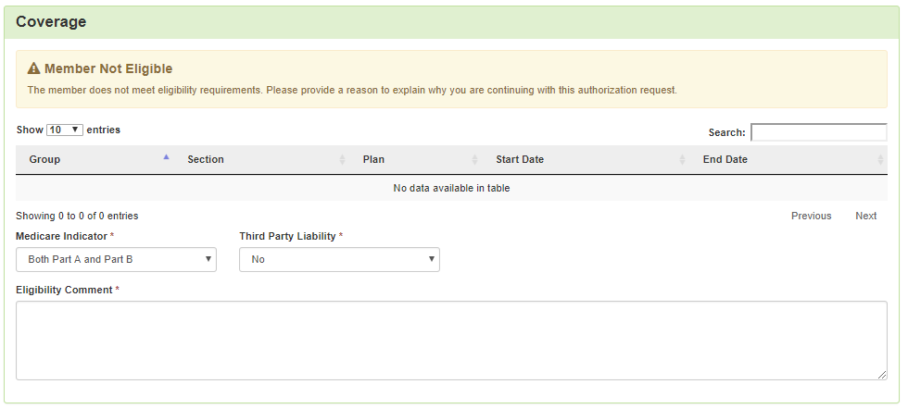
Coverage Panel
The Coverage Panel will detail information about the member’s eligibility.
The Medicare Indicator and Third Party Liability will default to No/Not Supplied unless there is information from the file.

Slide 38
Coverage Panel
There is an Eligibility comment box where you can enter information related to the member’s eligibility, if applicable

Slide 39
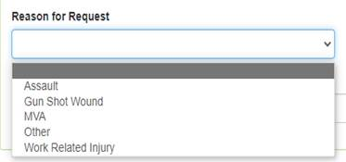
Supporting Information Panel
Reason for Request

Slide 40
Supporting Information Panel
Reason for Request
From the drop-down select one reason for the request:
Assault
Gunshot Wound
MVA
Other
Work Related Injury

Slide 41
Providers Panel
The Providers Panel asks for information related to the Air Ambulance Provider, Sending Facility, and Receiving Facility. You will click the Add button on each of the provider boxes to fill in the necessary provider information.

Slide 42
Entering Provider and Facility Information
Clicking Add will open a search box. You can search by entering a NPI number or by filling in any of the information boxed provided.
Once you have entered the necessary information, press search to locate the provider or facility you are looking for.

Slide 43
Entering Provider and Facility Information
Pressing search will return any results that meet your entered criteria.
Use the green plus box next to the name to select the provider/facility that you need for the review. You need to select the name associated with the provider file source.

Slide 44
Entering Provider and Facility Information
You will see the provider name or facility name and information populated in the corresponding panel.
Using the trash can by clicking the 3 dots under the Action tab is used to delete an incorrect selection
Reselect the add button to search and find a new provider/facility for the one that was deleted.

Slide 45
Diagnosis Panel
The Diagnosis Panel is where you can enter the diagnosis information related to this review.
You will use the Add button to add a new diagnosis to the panel.
You can enter as many diagnosis as needed.
You do have the ability to drag and drop if more than one diagnosis is entered to reorder them.

Slide 46
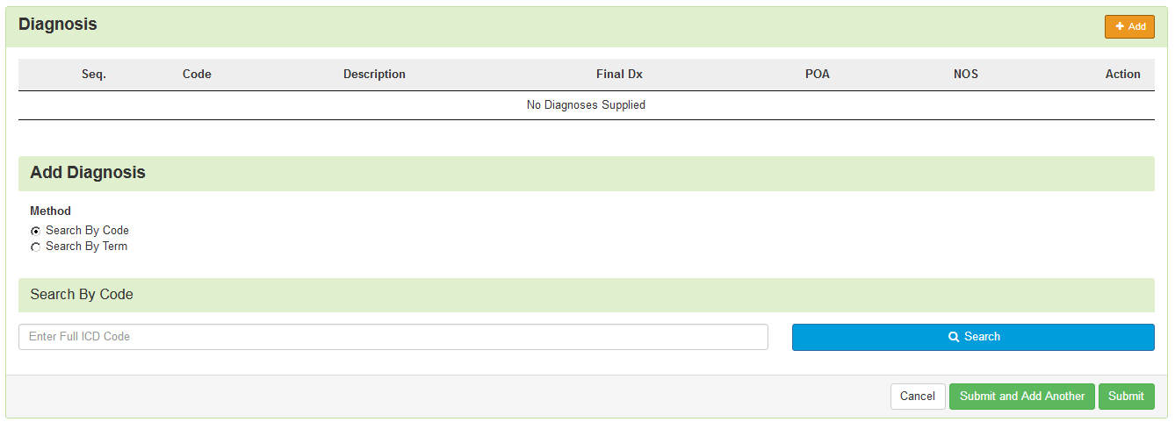
Diagnosis Panel
Once you click add, you will have the ability to search for a diagnosis either by Code or by Term.
Searching by code will let you enter a code directly and search for it, as shown in the example below.

Slide 47
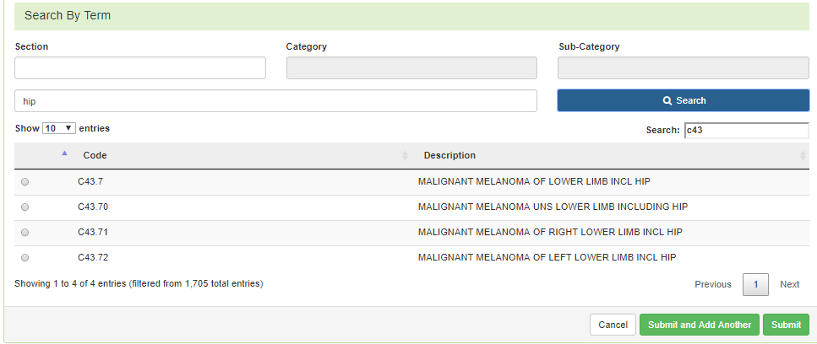
Diagnosis Panel
After entering a code or term to search by and clicking search, the system will provide you a list of results you can select from. Select the one that you want added to the review by clicking on the radio button to the left of the code.

Slide 48
Diagnosis Panel
After selecting the diagnosis you want added to the review, you can select Submit or Submit and Add Another.
Submit will add the diagnosis to the review.
Submit and Add Another will allow you to submit the diagnosis to the review and re-open the window where you can search for another diagnosis.
You can use the trash can icon on the right side of the diagnosis to delete anything entered incorrectly in this panel.

Slide 49
Procedures Panel
Under the Procedures Panel the procedure code information related to this review is entered.
The codes for Air Ambulance and mileage will pre-populate for this review type: A0431 and A0436

Slide 50
Air Ambulance
Each line item requires editing
A0431 Transport 1 way requires a cost
A0436 Mileage requires unit adjustment and cost
This is done by clicking on the edit box under the Action tab

Slide 51
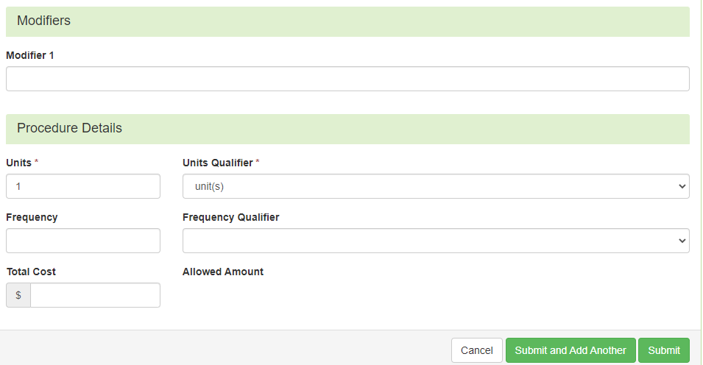
Procedures Panel
After clicking on the edit tab, the panel will expand for editing the information
Not required
for this review
1 unit
equals
1 mile
$1500 or
$20 x # of units

Slide 52
Documentation Panel
The Documentation Panel is the final panel on the page to submit the review. This is where you can upload any clinical documentation related and necessary for the review to be processed.

Slide 53
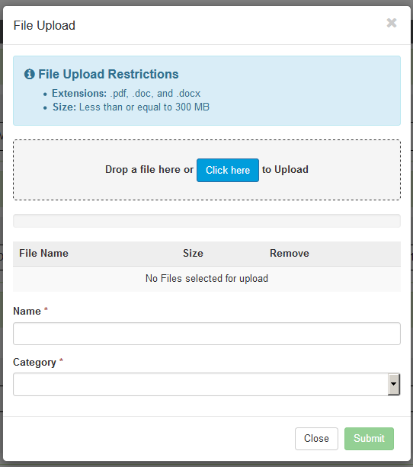
Documentation Panel
To submit documentation, click the Add button on the Documentation Panel. This will open a modal where you can drag and drop files or select Click here to open a windows directory and find the necessary files.

Slide 54
Documentation Panel
Please note:
Documents must be a .pdf or word document.
The file name cannot have any spaces or special characters in it.
The name can be changed in the Name box to what makes sense if needed.

Slide 55
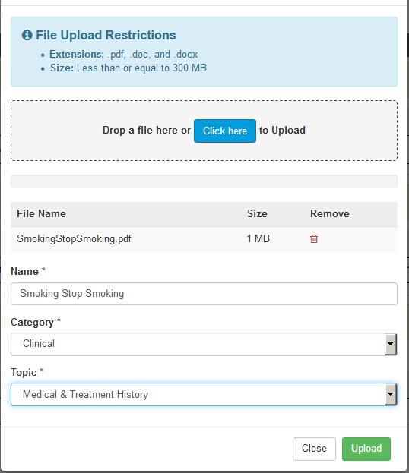
Documentation Panel
Please note:
The Category allows you to select the type of document that you are attaching. This will most always be clinical.
The topic is the type of clinical.
Click Upload to attach the information to the review.
This can be repeated as many times as necessary to get all relevant documentation added.

Slide 56
Documentation Panel
Once all the panels have been filled out, click Continue in the bottom right of the page to finalize the review.

Slide 57
MCG (Formerly known as Milliman Care Guidelines)
Once you have entered the information on the first page and clicked continue, the system will take the submitter through the documentation of clinical criteria
The system will take you to the MCG tool where this will happen.
To document the clinical criteria, click the Document Clinical button.

Slide 58
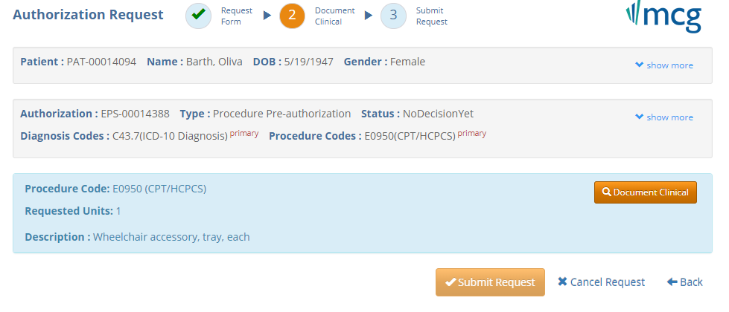
MCG

Slide 59
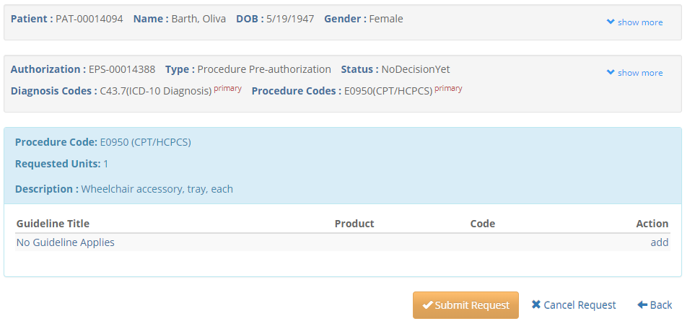
MCG
Click Add under the Action column to include the necessary guidelines

Slide 60
MCG
Once all applicable data has been entered, click the save button to finish the documentation.

Slide 61
MCG
Once all documentation is entered, click the Submit Request button to finish this section and return to finalizing the review.

Slide 62
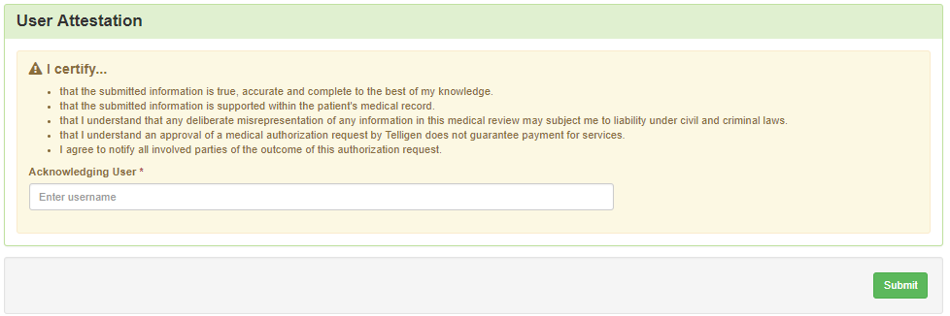
Attestation
The last piece of submission is to enter your username in the attestation section and click the Submit button to send the review to Telligen.

Slide 63
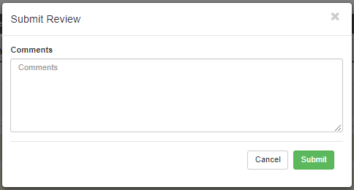
Comments
Users do have the option to add comments to the review before it is sent to Telligen.
A comments box will open and the user can enter additional information related to the review.

Slide 64
Summary
After submitting or canceling the comment box, you will be taken to a summary of the review.
Users will have the option to Edit, Delete, or leave the review.
To leave, scroll down through the entered information and confirm that everything submitted looks correct. Click on the Done button at the bottom of the page.
This will return the user to the tasks page where you can begin a new search and submit other reviews.

Slide 65
Review Details
Once a review has been submitted, you can find the review by searching for the Case ID or by searching for the member and looking at the UM panel in the Member Hub.
Once you have located the review in the Member Hub, a user can take multiple actions on the review such as:
View the Review to check for determination and any correspondence
Submit a Reconsideration
Delete a review that was submitted incorrectly

Slide 66
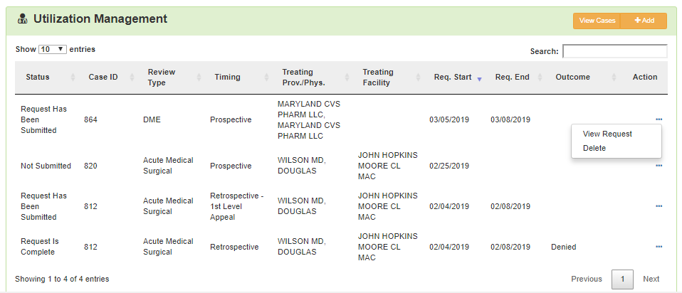
Review Details
Once in the review detail, you can click on the ellipsis at the right side of the line to open a menu.
If the review does not have a decision, users will have the option to view the request or to delete the request.

Slide 67
Request for Information
When a review has been looked at by a nurse and the nurse needs additional clinical documentation, a user will see a Request for Information task in the Scheduled Task queue.
Click on the ellipsis to the left of the page, to start the task.

Slide 68
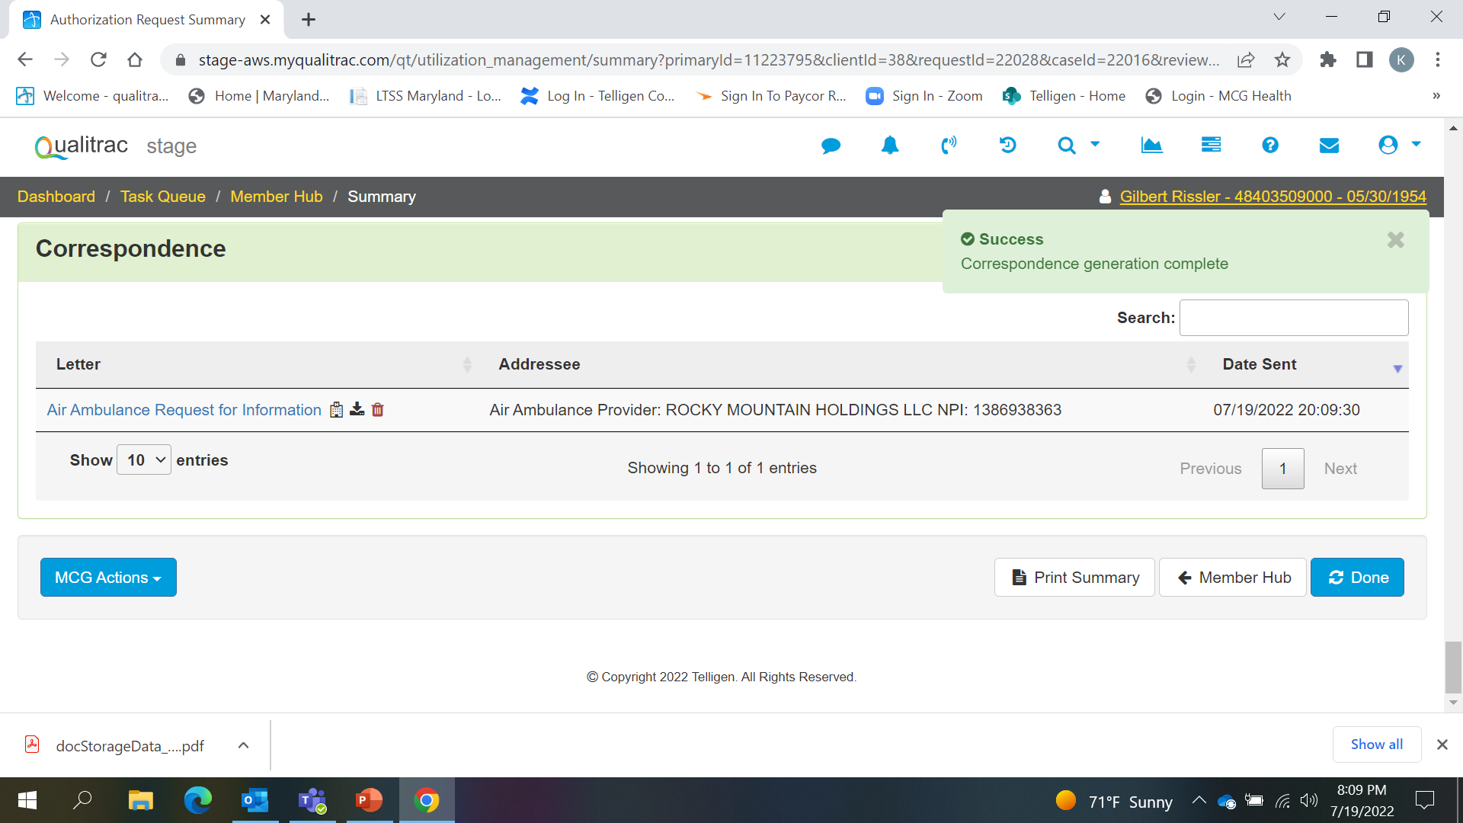
Request for Information
Scroll down the summary page of the review, to view the correspondence section.
Click on the blue name of the letter to open it and see what information is being requested.

Slide 69
Request for Information
Scroll up to the Documentation panel to attach additional information.
Click on the Add button, as was demonstrated earlier in the presentation, to attach additional clinical documentation to the review.

Slide 70
Request for Additional Information
Once you have added all the necessary information, scroll to the bottom of the page and click the Done button.
Clicking the Done button will finalize the request and send it back to the nurse to finish the review.
Once you click done, the system will return you to the Scheduled tasks queue and the task will no longer be visible for the user.
Do NOT create a new review to add additional clinical information to a current review. This causes a delay in processing your review. Please follow the steps as explained to make this process as quick as possible.

Slide 71
View Outcomes
Search for the case using the case ID or search for the member and go to the member hub.
At the member hub, click on the ellipsis on the right side of the page in line with the review you are searching for and select View Review.
Once the review is open, scroll down the page to the Outcomes panel.
Click on the dark brown section of the panel to open it to view the details.

Slide 72
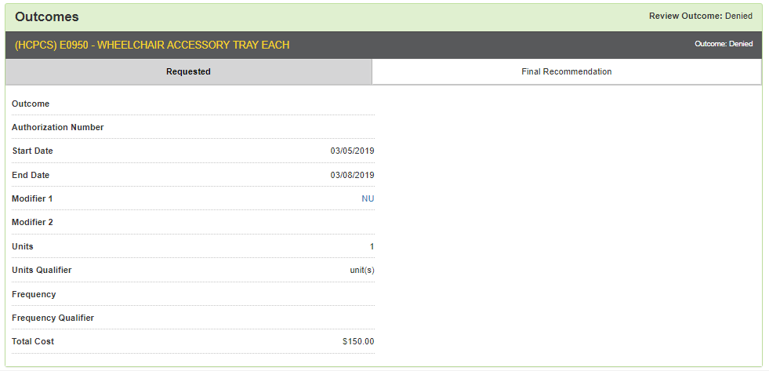
View Outcomes
The panel defaults to showing what was requested in the review. The panel with Requested is a darker gray.

Slide 73
View Outcomes
Click on the bar with Final Recommendation to see the determination.

Slide 74
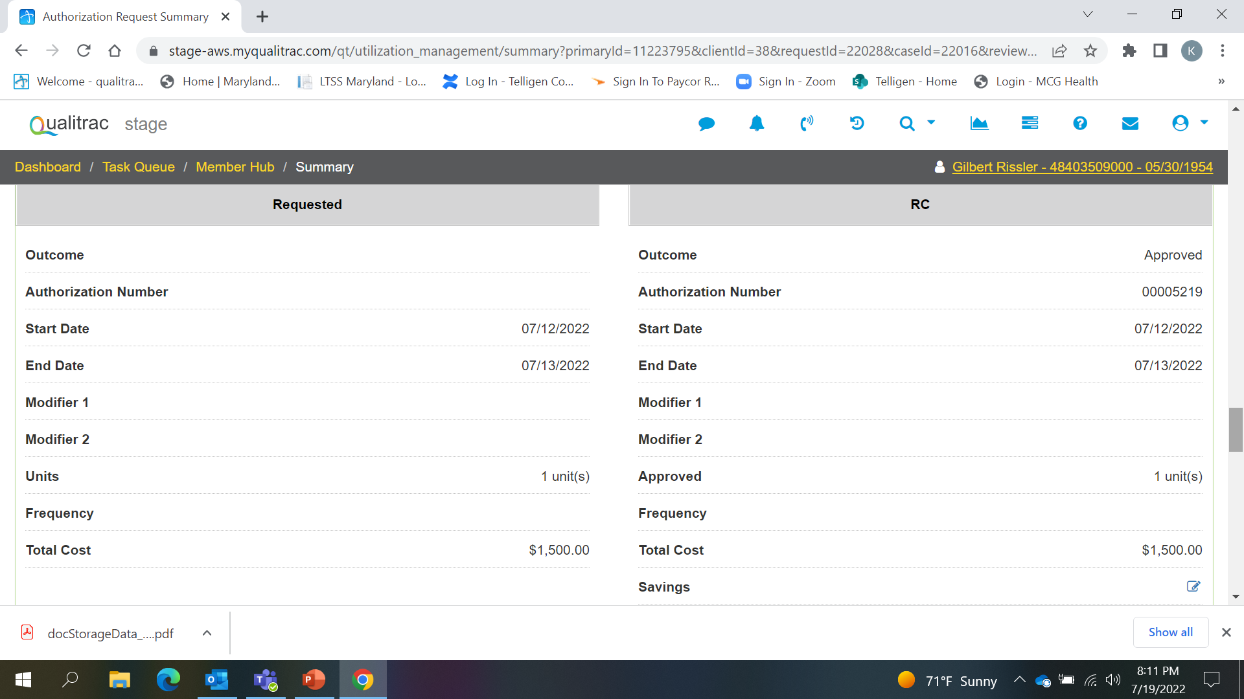
View Outcomes

Slide 75
Reconsideration Request
To submit a reconsideration for a denied review, go to the UM panel in the member hub and click on the blue ellipsis to open the action menu.
Once there, select “1st Level Appeal” from the menu.

Slide 76
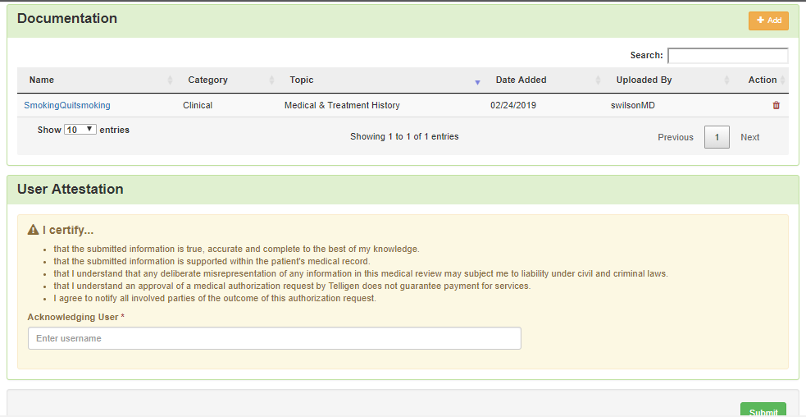
Reconsideration Request
Attach any additional documentation that is necessary to support the reconsideration request and enter your user id in the Attestation section. Click Submit to send the appeal to Telligen for review.

Slide 77
E-mail Notifications
Users will continue to receive email notifications when:
Reviews are received from the portal
Reviews are updated/changed in status
To make sure that everyone in your organization that should receive email notification for reviews does get one, please select the organization or facility in the Provider Organization Visibility panel.

Slide 78
Contact information
Maryland UC Support
Email: MarylandUCSupport@telligen.com Phone: (888) 276-7075
Please bookmark the telligenmd.Qualitrac.com webpage

Slide 79
Questions
?

