Slide 1
Maryland UCA:
Telligen Provider Portal Training – PACE
September 2024

Slide 2
Agenda
Contact Information
Overview/Purpose
Housekeeping
Telligen/Maryland Medicaid Website
Authorized Officials
How to log-in
How to enter a review
Completing the Request for Information (RFI)
How to find a review outcome
Submitting a reconsideration/appeal
E-mail notifications
Questions

Slide 3
Contact Us
Program Director
Rhonda McLaughlin
Website: https://telligenmd.Qualitrac.com
Maryland Call Center & Provider Help Desk
Email: MarylandUCSupport@telligen.com
Toll-Free Phone: 888-276-7075
Portal Registration Questions
Email: qtregistration@telligen.com
Toll-Free Phone: 888-276-7075

Slide 4
Purpose
To provide step by step instruction for using the provider portal
Deliver a review of the Portal security
Step by step instruction for entering a review
Instructions on completing the Request for Information process
How to find a determination status after submitting a review
Instructions on submitting a reconsideration/1st level appeal
Review of the notifications you will receive
Directions on requesting a Peer-to-Peer

Slide 5
Housekeeping
Questions
Please enter all questions into the chat
Time at the end of the training will be reserved for questions
Any unanswered questions will be answered and posted to the website
Content availability
Presentation will be posted to the website following the training
Website: https://telligenmd.Qualitrac.com
Located in Education/Training
Survey
All registrants will be sent a Survey via email following today’s training. Telligen welcomes your feedback and suggestions on future training opportunities.

Slide 6
How do I access the Telligen Provider portal (Qualitrac)?:
Website Introduction

Slide 7
Telligen Provider Portal - Overview
The Telligen Provider Portal, Qualitrac, is a web-based application that allows healthcare providers to submit review requests.
Please bookmark the https://telligenmd.Qualitrac.com webpage.
Use the Log-In link provided to access Qualitrac.

Slide 8
Telligen Landing Page Overview
Please bookmark this site: https://telligenmd.Qualitrac.com

Slide 9
Provider Portal Overview
The Provider Portal is a web-based application that allows healthcare providers to submit PACE reviews
The Provider Portal utilizes a delegated security model.
A delegated security model requires an organizational executive (Provider Executive) to “delegate” administrative rights to one or more individuals within their organization (Authorized Official).
There should be at least one Authorized Official per provider organization. The Authorized Official will:
Be the point of contact for the organization
Add, remove or edit Provider Users accounts
PLEASE NOTE - HIPAA compliance require all staff entering reviews or
accessing the portal MUST have their own log-in and password. Do not create generic log-ins.

Slide 10
Registration Reminder
Process Overview
The registration process can be completed at: https://telligenmd.Qualitrac.com
Click the registration button :
Refer to the Authorized Official recording for step-by-step instructions

Slide 11
Introduction to Authorized Official (AO) Registration

Slide 12
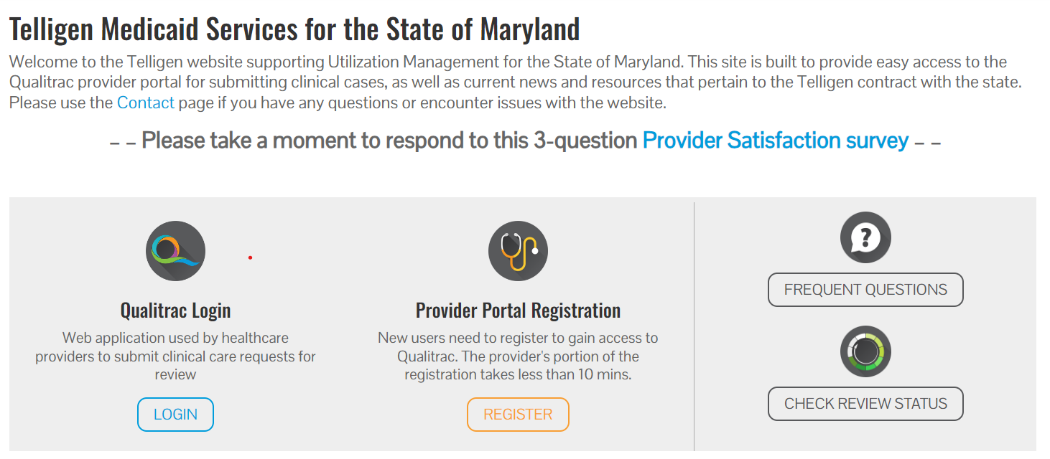
Provider Portal Registration
The Provider Portal Registration process can completed entirely online.
Information on how to complete the registration can be found on the website https://telligenmd.qualitrac.com
Click on the “Register” link in the center gray section of the website.

Slide 13
Provider Portal Registration
The Registration Process requires your organization to appoint individuals to authorize and administer your account.
The Provider Executive, i.e., is the duly authorized representative permitted to bind your organization, agrees to the terms and conditions of the Provider Portal Agreement. (Someone with contracting and purchasing authority in your organization such as CEO, CFO, COO, etc.)
The Provider Executive designates one or more Authorized Officials for your organization. These individuals will manage provider accounts within your organization. (No more than three (3) per organization)
The Authorized Official(s) complete(s) the Authorized Official Agreement and Registration Form.

Slide 14
Provider Portal Registration
The registration can be completed in a few simple steps:
All forms are completed online.
Using DocuSign technology, the documents are routed via email to the appropriate parties for signature.
Once everyone has signed, both the Provider Executive and the AO(s) receive a fully executed agreement for their records.
The Qualitrac Registration team will then complete the registration process and provide instructions to the AO(s).
The AO(s) from your organization will then need to create and manage provider accounts within your organization.

Slide 15
Provider Portal Registration
Two emails will be sent to the AO(s) once the registration packet is processed:
One from QTRegistration@telligen.com with a username and link to the portal.
One from the Qualitrac system with a link to activate your account and create your password.
Once the AO is logged in to the system, they can set up accounts for other individuals in the organization to access and use the portal

Slide 16
Authorized Official (AO) Training

Slide 17
Authorized Official (AO) Training
The AO training user guide can be found on the website on the “Education & Training” page.
The User Guide can assist you with:
Adding additional Users
Viewing User account details
How to help with password resets
Deactivating Users
The latest Authorized Official (AO) Training Guide can be found at:
https://telligenmd.qualitrac.com/Education-training/

Slide 18
Provider Portal:
How to Log in

Slide 19
Provider Portal
Each user will be assigned a unique username for the portal.
Please go https://telligenmd.Qualitrac.com and use the sign-in link

Slide 20
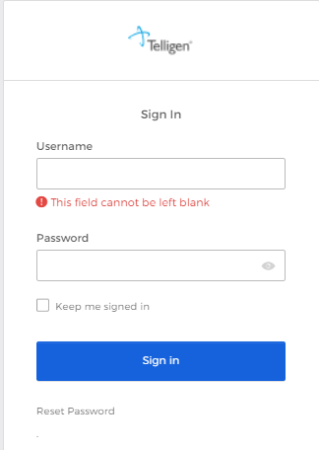
Signing into the Provider Portal
Enter Username: Use the username that you were sent in the set-up email.
Enter Password: Use the temporary password you were sent in the set-up email.
Click Sign In to access the system
Use the reset password link at the bottom to reset password after your first log in and anytime your password needs reset.

Slide 21
Portal

Slide 22
Provider Portal: Landing Page
This is the Telligen Provider Portal Menu Bar. This will remain available to you wherever you are in the system.
The Qualitrac Logo will take you back to the landing page from wherever you are currently working at in the system.
The bell icon notifies the user of notifications and system messages
The “magnifying glass” icon will open search options for you to search for a specific case or a specific member to view the details.
This is utilized to view and manage your profile. If your phone number or email address changes, you can use this section to update the details.
This icon allows for quick access to the users Task List

Slide 23
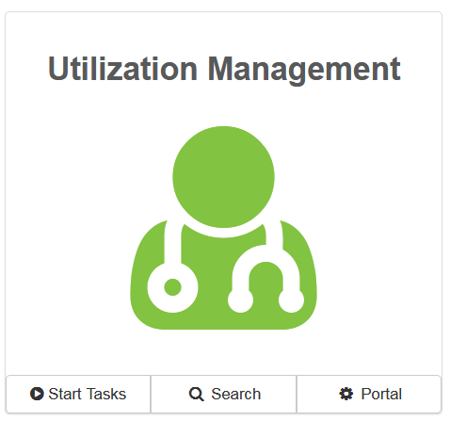
Telligen Provider Portal – Landing Page
Start Tasks will take you to the task queue to view any reviews where additional information has been requested
Search will allow you to search for a member or a case. Just like the magnifying class at the top of the page.
Portal will take you to the portal or to the task queue.

Slide 24
Submitting a Review

Slide 25
Telligen Provider Portal – Adding a New Review
Click on the box or the “magnifying glass” icon in the tool bar to access the member search screen to look for information on a member or to start a new review.

Slide 26
Telligen Provider Portal – Adding a New Review
How To Locate a Member:
Enter the Member’s ID and Date of Birth OR
Enter the member’s First Name, Last Name, and Date of Birth
NOTE: The Member ID and the Date of Birth must match with what is on file in the MMIS system to locate the member information or to begin a new review for that member.

Slide 27
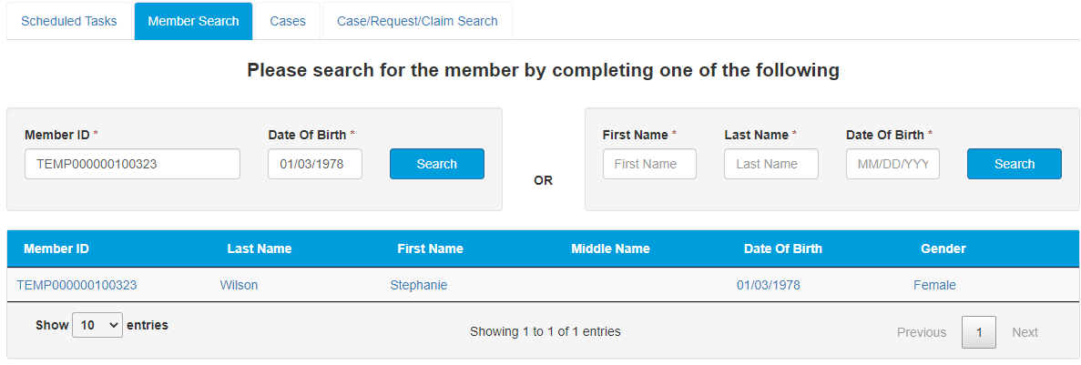
Telligen Provider Portal – Adding a New Review
The member(s) matching the criteria entered will populate
Select the appropriate member
Click on any of the data fields in blue to access the member information or to start a new review for the member.

Slide 28
Telligen Provider Portal – Adding a new review
The Member Hub:
The Telligen Provider Portal allows you to view information related to this member based on rights of your role.
You will be able to see their contact information
You will be able to see any reviews that have been submitted for them on behalf of your organization.

Slide 29
Telligen Provider Portal – View Member Details
Clicking on the View Member Details box opens the window to provide the user with more information for the member.

Slide 30
Telligen Provider Portal – Utilization Management Panel
The Utilization Management Panel will contain all information related to all UM reviews submitted for the member on behalf of your organization or those that were shared with your organization through the provider visibility panel
Use the button to start a new request.

Slide 31
Telligen Provider Portal – Required sections
The following panels will be required for your request:
Authorization Request
Dates of Service
Coverage
Providers
Provider Organization Visibility
Diagnosis
Procedures
Documentation
We will review each of these sections

Slide 32
Telligen Provider Portal – Add New Request
To begin a new request, fill in the Authorization Request panel.
Date will prepopulate with the current date

Slide 33
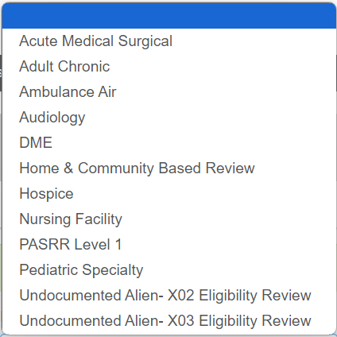
Authorization Request Panel- Review Type
Enter the Review Type: This is where you will select the type of review you are requesting.
The review appropriate for this include: Home & Community Based Review
Content will be located under education on the website

Slide 34
Authorization Request Panel cont.
Place of Service: This is where you will select the place where care is being provided: Outpatient
Type of Service: This Is the type of service being requested.
Hospice
Timing: This is where you will select Prospective
Select Add New Request to complete the process.
If the request was entered in error, you can select Cancel to remove the request

Slide 35
Dates of Service Panel
Once you select Add New Request, the page opens to fill in all the remaining information necessary to process the request.
Dates of Service Panel is used to enter the Service Start Date and the Service End Date.

Slide 36
Coverage Panel
The Coverage Panel will provide detailed information about the member’s eligibility.
The Medicare Indicator and Third-Party Liability will default to No/Not Supplied unless there is information from MMIS stating that the member has Medicare or other insurance.

Slide 37
Coverage Panel cont.
There is an Eligibility comment box where you can enter information related to the member’s eligibility.
This will also allow the submitter to override lack of eligibility for those member’s whose eligibility may be at a future date and the request is being submitted in advance.

Slide 38
Providers Panel: Physician and Provider Information
Providers: This section requires information related to who is ordering and providing the care:
Ordering Provider- The person or Organization ordering the care
Treating Provider – The organization providing the care
click the Add button on each box to fill in the necessary provider information

Slide 39
Entering Physician and Facility Information
Clicking will open a search box. You can search by entering an NPI number or by filling in any of the information boxes provided if the NPI is not known.
Once you have entered the necessary information, click search to locate the physician or facility you are looking for.

Slide 40
Entering Physician and Facility Information
Clicking search will return all results that meet your entered criteria.
Click the blue hyperlink in the provider's name to view additional details.
Check the provider details before selecting, validating the correct provider and the taxonomy ID aligns to the services being requested
Use the green plus box next to the name to select the provider/facility that you need for the review.

Slide 41
Entering Physician and Facility Information
You will see the physician's name or facility name and information populated in the corresponding panel.
You can access the delete button by clicking the 3 dots to the right if selected in error
You can use the button to search and find a new physician/facility for the one that was deleted.

Slide 42
Provider Organization Visibility Panel
Provider Organization Visibility: This box is not required but it allows you to share this review with everyone in the organization you are submitting it for.
This will also allow you to share the review and allow visibility by the Treating Providers organization for their knowledge and information

Slide 43
Diagnosis Panel
Diagnosis Panel: This is where you can enter the diagnosis information related to this review.
You will use the button to add a new diagnosis to the panel.
You can enter as many diagnoses as needed.
You do have the ability to reorder or prioritize the diagnoses using the drag and drop feature.

Slide 44
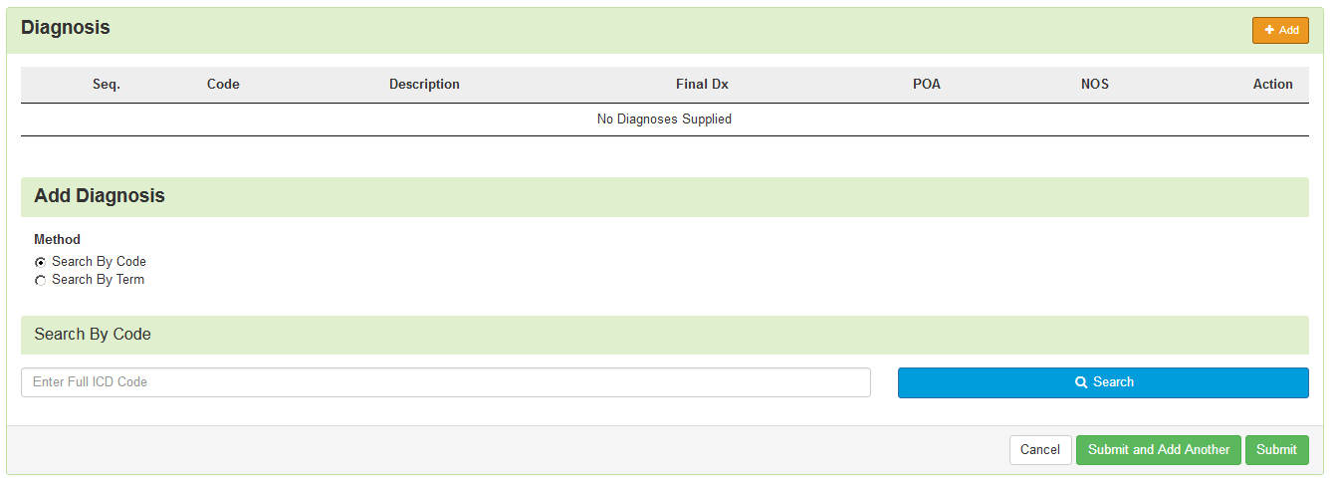
Diagnosis Panel cont.
Once you click , you will have the ability to search for a diagnosis either by Code or by Term.

Slide 45
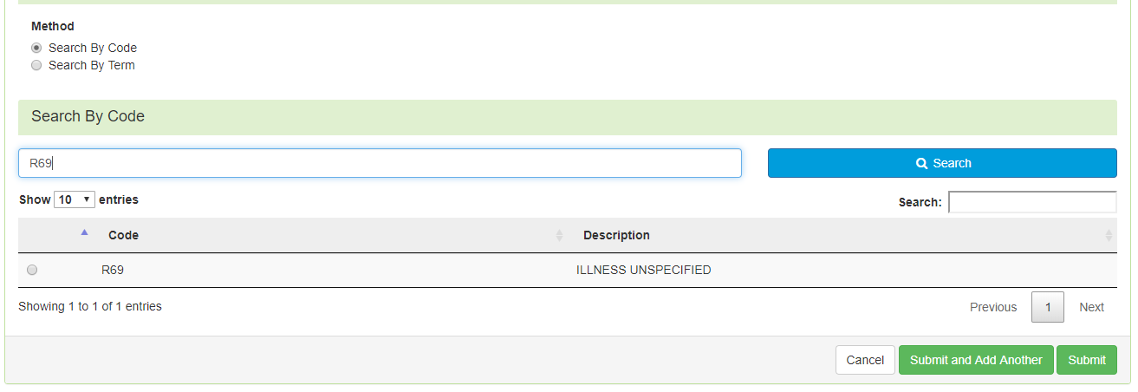
Diagnosis Panel: Populating the Diagnosis
Entering a code:
Select method: Code or term to search (radio button to select)
Enter information in the search box
Click Search
The system will provide you a list of results you can select from. Select the one that you want added to the review by clicking on the radio button to the left of the code.

Slide 46
Diagnosis Panel cont.
After selecting the diagnosis you want added to the review, you can select Submit or Submit and Add Another.
Submit will add the diagnosis to the review.
Submit and Add Another will allow you to submit the diagnosis to the review and re-open the window where you can search for another diagnosis.
You can use the trash can icon on the right side of the diagnosis to delete anything entered incorrectly in this panel.

Slide 47
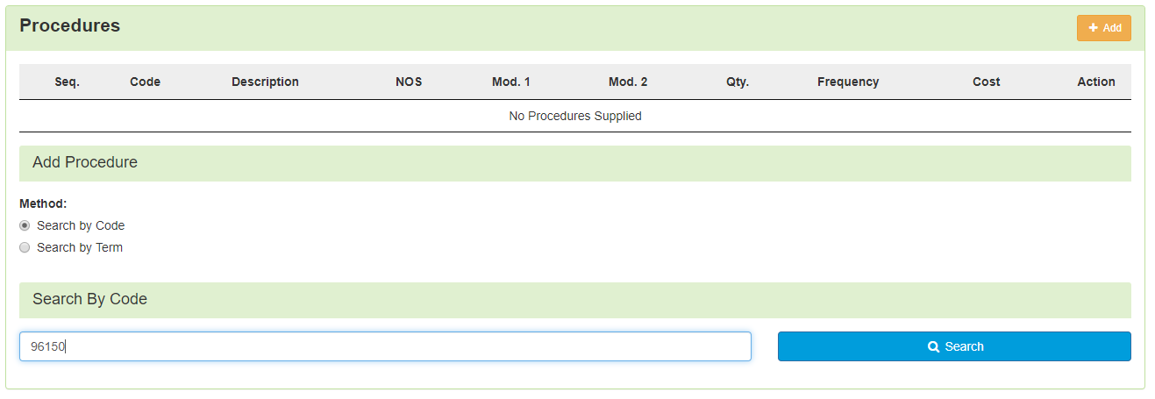
Procedure(s) Panel
The Procedures Panel is where the procedure code information related to this review is added.
Click the button to add a new procedure to the panel.
Select Radio button to indicate a code or term search
Enter information in the search box
Click search
For PACE reviews the Procedure field will be pre-populated

Slide 48
Procedure(s) Panel cont.
The Term search allows for the user to search based on Section, category and sub-category if needed
Once Query has populated, Use the radio button to Select the correct Procedure(s)

Slide 49
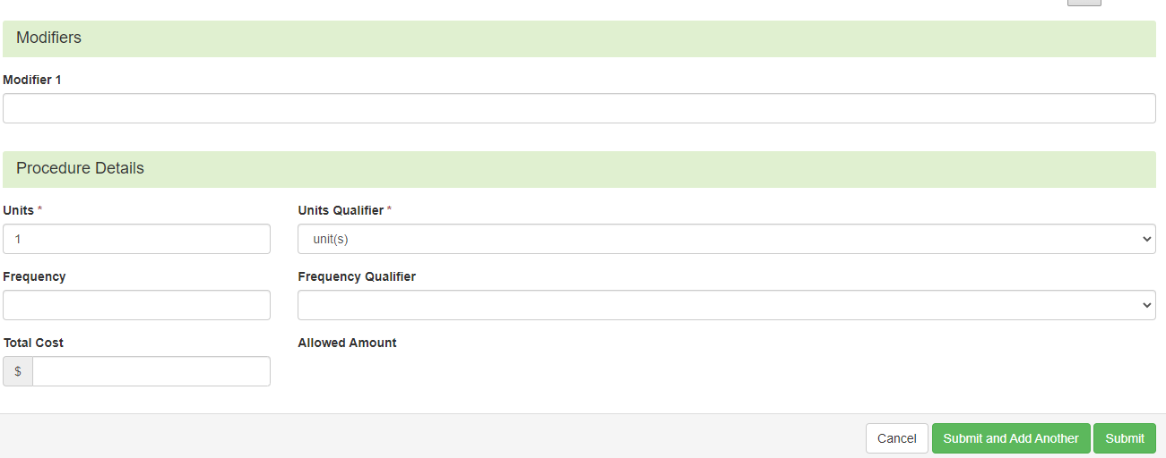
Procedure(s) Panel cont.
Complete Modifiers and procedure details as needed
After selecting the procedure(s) you want to be added to the review:
Submit will add the procedure to the review.
Submit and Add Another will allow you to submit the procedure to the review and re-open the window where you can search for another procedure.
Enter as many procedures as needed.
The units should be the number of days for the benefit period.

Slide 50
Procedure(s) Panel cont.
Use the trash can icon on the right side of the procedure to delete anything entered incorrectly in this panel.
Prioritize the procedures using the drag and drop features.

Slide 51
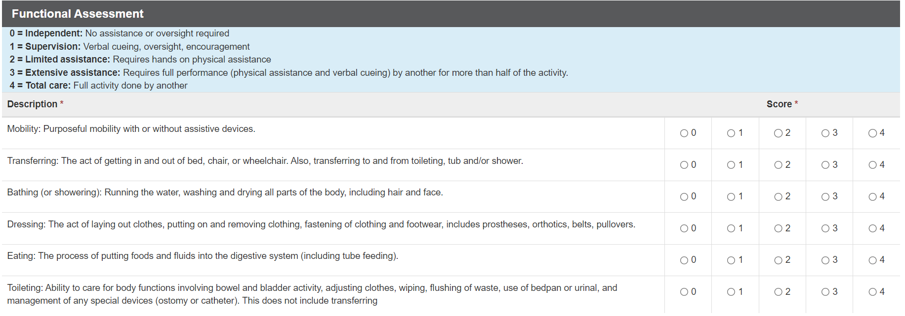
Assessment Panel
You will need to complete the patient assessment, which mirrors the 3871b

Slide 52
Documentation Panel
Documentation Panel is the final panel on the page to submit the review.
This is where you can upload any clinical documentation related and necessary for the review to be processed.

Slide 53
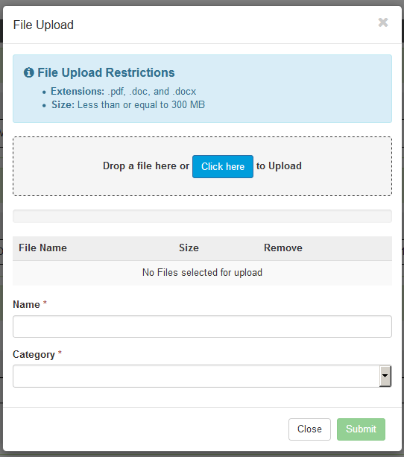
Documentation Panel cont.
To submit documentation, click the button on the Documentation Panel. This will open a modal where you can drag and drop files or select Click here to open a windows directory and find the necessary files.

Slide 54
Documentation Panel cont.
Please note:
Documents must be a .pdf or word document
The size is limited to 300MB per document.
Complete the File upload fields
Name:
The Name box allows you to name the file to what makes sense, if needed
The file name cannot have any spaces or special characters.

Slide 55
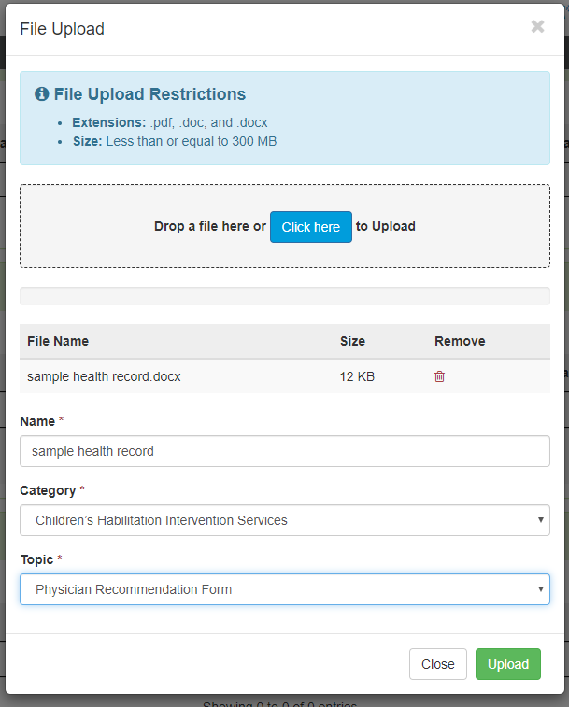
Documentation Panel cont.
Category:
select from the drop down the type of document that you are attaching.
Topic:
Select from the drop-down type of document being attached.
Click Upload to attach the information to the review.
NOTE: This can be repeated as many times as necessary to get all relevant documentation added.
Notes:
. Please verbally provide the list of available topics

Slide 56
Required Documentation
Completed 3871b - electronic
Documentation to support the answers on the 3871
Physician’s orders
Physician progress notes
5. Psychological evaluation, if appropriate
6. Discharge summary from recent hospitalization, if within the last 2 months
All documentation must be dated and signed (electronic signatures are accepted).
All documentation must include 2 patient identifiers
For example – patient name and Medicaid ID number or patient name and date of birth (DOB).

Slide 57
Completing your Review
Once all the panels have been filled out, click Continue in the bottom right of the page to complete the review.

Slide 58
MCG
Once you have entered all of the information on the first page and clicked continue, the system will take the submitter through the documentation of clinical criteria
The system will take you to the MCG tool where this will happen.
To document the clinical criteria, click the Document Clinical button.

Slide 59
MCG
After you complete the document upload, you will be taken to MCG. This is a system requirement.
Click on Document Clinical.

Slide 60
MCG Cont
Click on No Guideline Applies and enter a comment.
Click on Save.
Click on Submit Request.

Slide 61
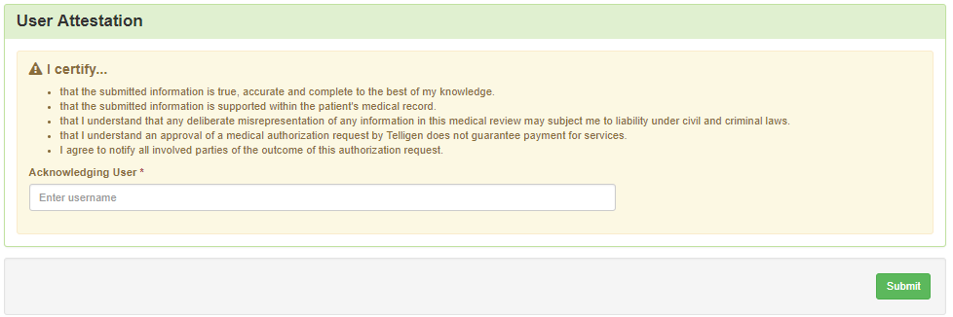
Attestation
The last piece of submission is to enter your Username in the attestation section
Click the Submit button to send the review to Telligen
If any information is missing, an error will indicate what is missing

Slide 62
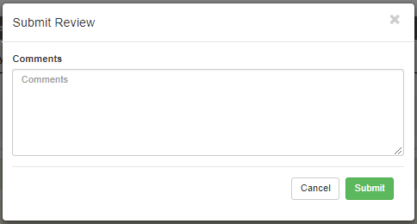
Comments
Users have the option to add comments to the review before it is sent to Telligen.
A comments modal will open, and the user can enter additional information related to the review.
This is not required to complete the review.

Slide 63
Summary
After submitting you will be taken to a summary of the review
Users will have the option to Edit or Delete via the button
To navigate off of the request, scroll to the bottom of the page and select
This will return the user to the tasks page where you can begin a new search and submit other reviews.

Slide 64
Where Did My Review Go?
Once a review has been submitted, you can find the review by:
searching for the Case ID
searching for the member and looking at the UM panel in the Member Hub.
Member Hub functions:
Allows the user to look at the Review to check for determination and any correspondence
Submit a Reconsideration which is titled 1st Level Appeal
Delete a review that was submitted incorrectly

Slide 65
Review
Once in the UM Panel:
Navigate to your request
Click on the ellipsis at the right side of the line request. This menu will allow you to view the request in more detail, submit a reconsideration (1st Level Appeal), and other options.

Slide 66
Request for Information (RFI)

Slide 67
Request for Information
When a reviewer needs additional clinical documentation to make a determination, the submitter will be notified that additional Information is needed.
Notification Methods:
Email to user that they have a request for more information
A task will populate in the Qualitrac system
User steps:
Log into Qualitrac
Proceed to scheduled tasks
Click on the ellipsis to the left of the page, to start the task.

Slide 68
Request for Information
Scroll down the summary page of the review
Proceed to the correspondence section.
Click on the blue name of the letter to open it and see what information is being requested.

Slide 69
Request for Information
Scroll up to the Documentation panel to attach additional information.
Click on the Add button to attach additional clinical documentation to the review.

Slide 70
Request for Additional Information
Once you add all necessary information, the system will trigger a task for the reviewer
Once you have added the additional information, the system will return you to the Scheduled tasks queue and the task will no longer be visible for the user.
**Do NOT start a new review to submit additional clinical information that was requested. This will delay the response. Please follow the steps outlined when a Request for Information task is available in the task queue.

Slide 71
Finding the Determination

Slide 72
Locating A Determination
To Locate the determination: Log in and select search under UM
Locate the member
Search for the case by using the case ID
Search by the member and locate the case in the member hub
Search Cases for the list of all auth requests
2
3
1

Slide 73
Locating A Determination
To Locate the determination:
If searching by the member, once in the member hub:
Scroll down to the Utilization Management section
Select the appropriate auth request (if multiple are present)
Click on the ellipsis on the right side of the page in line with the review you are searching for
Select View Request
If searching by Case ID
Upon selecting the case ID, you will be taken directly to the authorization request
If Searching by the case list, you will scroll to locate the case and select
Once the review is open, scroll down the page to the Outcomes panel
Click on the gray section of the panel to open it and view the details.

Slide 74
View Outcome

Slide 75
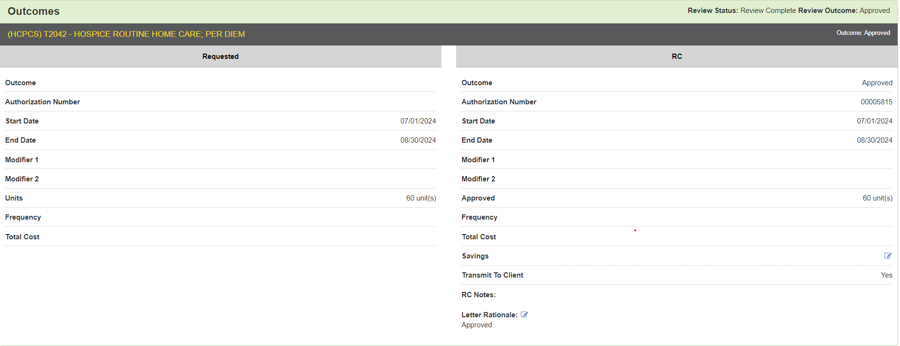
View Outcome

Slide 76
Submitting a Reconsideration
(1st Level Appeal)

Slide 77
Submitting a Reconsideration (1st Level Appeal)
To submit a reconsideration for a denied review:
Go to the UM panel in the member hub
Click on the blue ellipsis within the denied case to open the action menu
Once there, select 1st Level Appeal from the menu.

Slide 78
Reconsideration (1st Level Appeal) cont.
The system will ask you if you are sure you want to submit a 1st Level appeal
Select the green button : Request 1st Level Appeal
You will still be able to delete the request later
Attach any additional documentation that is necessary to support the appeal

Slide 79
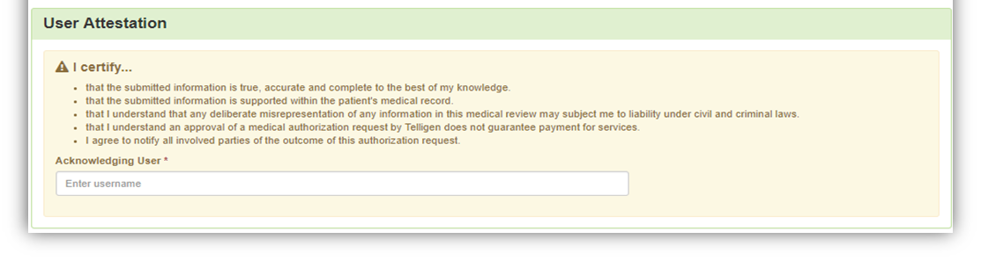
Reconsideration (1st Level Appeal) cont.
Sign the User Attestation using your USER ID
Click Submit to have the information sent to Telligen for reconsideration
The system will display your appeal

Slide 80
Reconsideration (1st Level Appeal)
When a concurrent review has an initial determination of denied or partially denied, the user can submit a request for a reconsideration review
The user must submit the request within 30 calendar days from the date and time the initial determination is rendered.

Slide 81
E-mail Notifications
Users will receive email notifications when:
Reviews are received from the portal
Reviews are updated/changed in status
To make sure that everyone in your organization that should receive email notification for reviews does get one, please select the organization or facility in the Provider Organization Visibility panel.

Slide 82
Contact Us
Program Director
Rhonda McLaughlin
Website: https://telligenmd.Qualitrac.com
Mississippi Call Center & Provider Help Desk
Email: MarylandUCSupport@telligen.com
Toll-Free Phone: 888-276-7075
Portal Registration Questions
Email: qtregistration@telligen.com
Toll-Free Phone: 888-276-7075

Slide 83
Questions
?

